Slide 1
Department of Computer Science & Engineering
UE17CS355 – Web Tech II Laboratory
Project Evaluation
Project Title : Car Resale Value Prediction
Project Team : PES1201700219 – Aninditha Ramesh
PES1201700297 - Sanjana Moudgalya
PES1201701536 - Anusha S Rao

Slide 2
Project Description
Cars4you is a website that helps users predict resale values of their cars. All that needs to be done is to enter details of the car such as Brand, Model, Distance covered and few others. Our well-trained model then comes up with a prediction.
Additionally, users can subscribe to our site for updates on cars up for sale. They will be contacted by our company to help them choose their perfect car.

Slide 3
Technologies Used
Front-end
AngularJS
Bootstrap
Javascript
Back-end
Flask
PHP

Slide 4
Techniques Implemented
Predictive Fetch
Used to build an auto complete feature for input text fields in prediction form
Multistage Download
Used to fetch only the page description on initial load, required images will be downloaded in stages gradually.
COMET
Used to fetch list of cars for sale from database

Slide 5
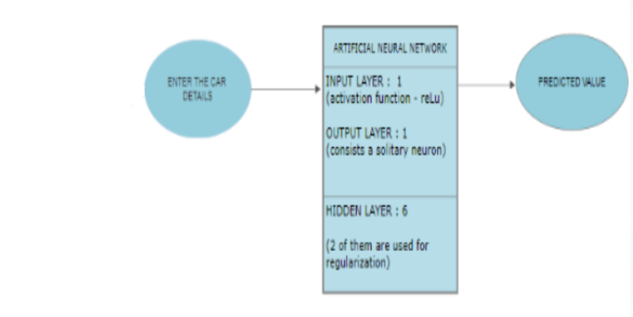
Intelligent Functionality
Artificial Neural Networks (ANN) was used to train the model, that was further used to predict the resale value for a car. Five hidden layers use ReLU as the activation function. The output layer consists of linear regression.
The R-squared value of the model is 0.84.

Slide 6
Thank You

